Slide 1

MOBILE DEVELOPMENT with the ABP Framework

Slide 2
Last & Next ABP Releases

Slide 3

ABP v7.3 Final
Released at July 12, 2023.
Blog Post (shortened) URL: https://abp.io/b/v73
Volo.Abp.Imaging.* Packages to manipulate (resize & compress) images
Nonce attribute support for Content Security Policy (CSP)
Monitoring distributed events in-process
Ordering execution of local event handlers
Many enhancements & bug fixes (700+ commits)

Slide 4
ABP v7.4 RC
Planned Release Date: August 15, 2023
ABP Framework
Dynamic setting store
Adding CorrelationId to distributed events
Do not expose integration services / controllers by default
ABP Commercial
Mobile Application
Revise the mobile application (React Native & MAUI) functionality and UI design
ABP Suite
Keep customized code on re-generation for CRUD page generation
Master/Detail entity support for CRUD code generation*
Modules:
Account/Identity: Password complexity indicator
Chat: Delete messages/converstations
Text Template Management: Support distributed systems for text template customizations

Slide 5
ABP v8.0 RC
Planned Release Date: November 15, 2023.
Based on .NET 8.0

Slide 6
ABP Community News

Slide 7
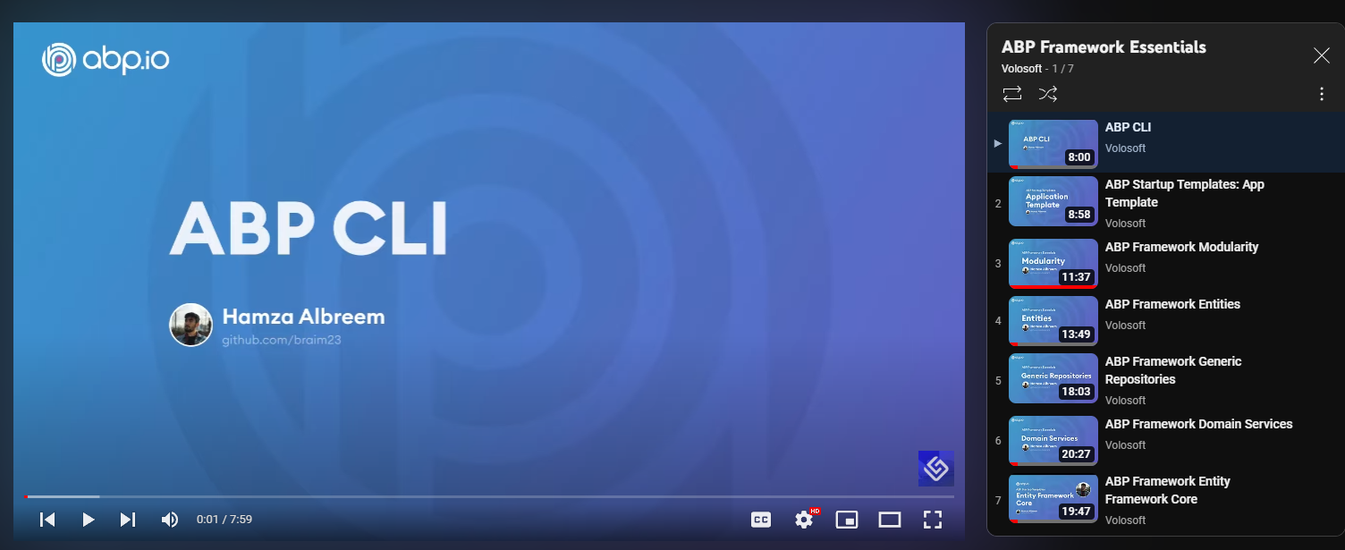
Video Series: ABP Framework Essentials 7 videos / 100 minutes of content
https://www.youtube.com/@Volosoft

Slide 8
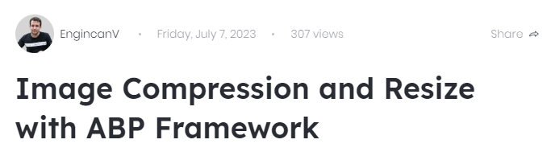
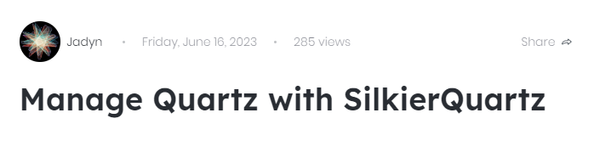
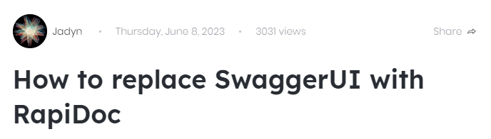
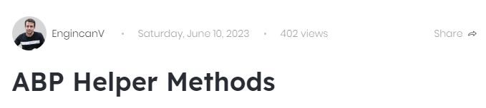
Latest Posts https://community.abp.io

Slide 9
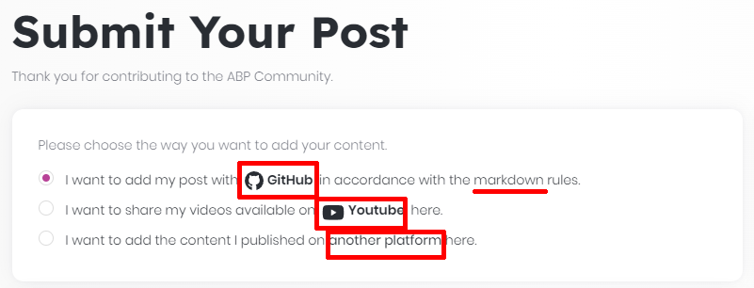
ABP Community Stats
163 Text Articles
96 Video Posts
By XXX Authors
In 3 Languages (English, Chinese, Turkish)
https://community.abp.io/posts/submit

Slide 10
Topic title
Content

